Slide 1





DEFCON: Generating and Detecting Failure-prone Instruction Sequences via Stochastic Search
Ioannis Tsiokanos*, Lev Mukhanov*, Giorgis Georgakoudis†, Dimitrios S. Nikolopoulos‡, and Georgios Karakonstantis*
*Institute of Electronics, Communications and Information Technology, Queen’s University Belfast, UK
†Center for Applied Scientific Computing, Lawrence Livermore National Laboratory, USA
‡Department of Computer Science, Virginia Tech, USA

Slide 2
Outline
Introduction & Motivation
Proposed approach & Design flow
Case study: application to an FPU
Experimental results
Conclusions

Slide 3
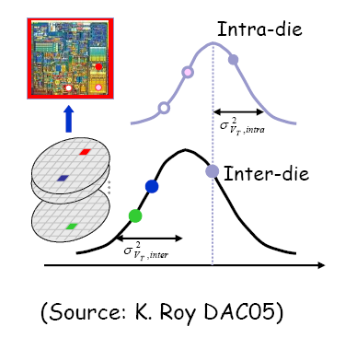
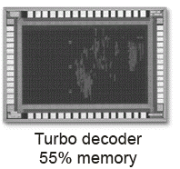




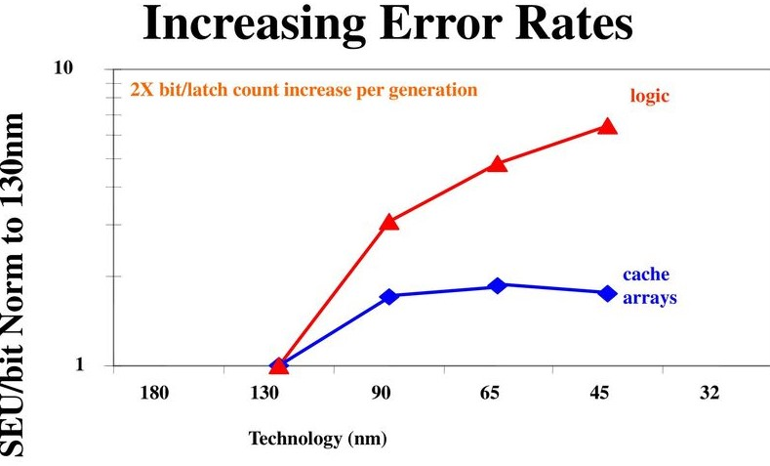
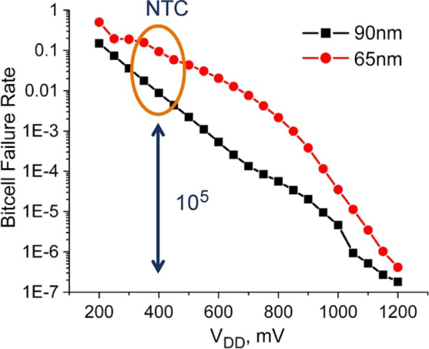
Challenge: Circuits more Prone to Failures
Static Variations
Dynamic Variations
Wear-out/Aging
failure
failure
Time [s]
Time [y]
Operations under scaled voltage for energy efficiency
More sensitive to failures
Source: Intel
Threaten System Functionality and Output Quality

Slide 4
Addressing Timing Failures
Error mitigation schemes that try to strike a balance between protection efficacy and energy based on:
adaptive voltage/frequency scaling
Impact evaluation of errors on micro-architecture/applications
error prediction/detection
Frameworks that try to model timing errors based on:
Statistical models
Machine learning algorithms
Stress code generation for testing the efficacy of developed methods
Identify in advance worst-case frequency/voltage fluctuations
✗ Errors are not related to the circuits
✗ Agnostic of the underlying hardware
✗ Ignore the impact of all the concurrently executed instructions on error rate
✗ Require custom-made infrastructure

Slide 5
Proposed Approach
DEFCON, a fully automated framework that:
Generates failure-prone
instruction sequences
Detects vulnerable code regions in applications
Our Contributions:
Analysis of the impact of instruction execution history
on error rate
Integration of a properly formulated genetic algorithm with accurate post layout gatelevel simulation
Introduction of an application vulnerability metric to quantify the application susceptibility to timing failures
DEtecting Failure-prone InstruCtiOn SequeNces (DEFCON)

Slide 6
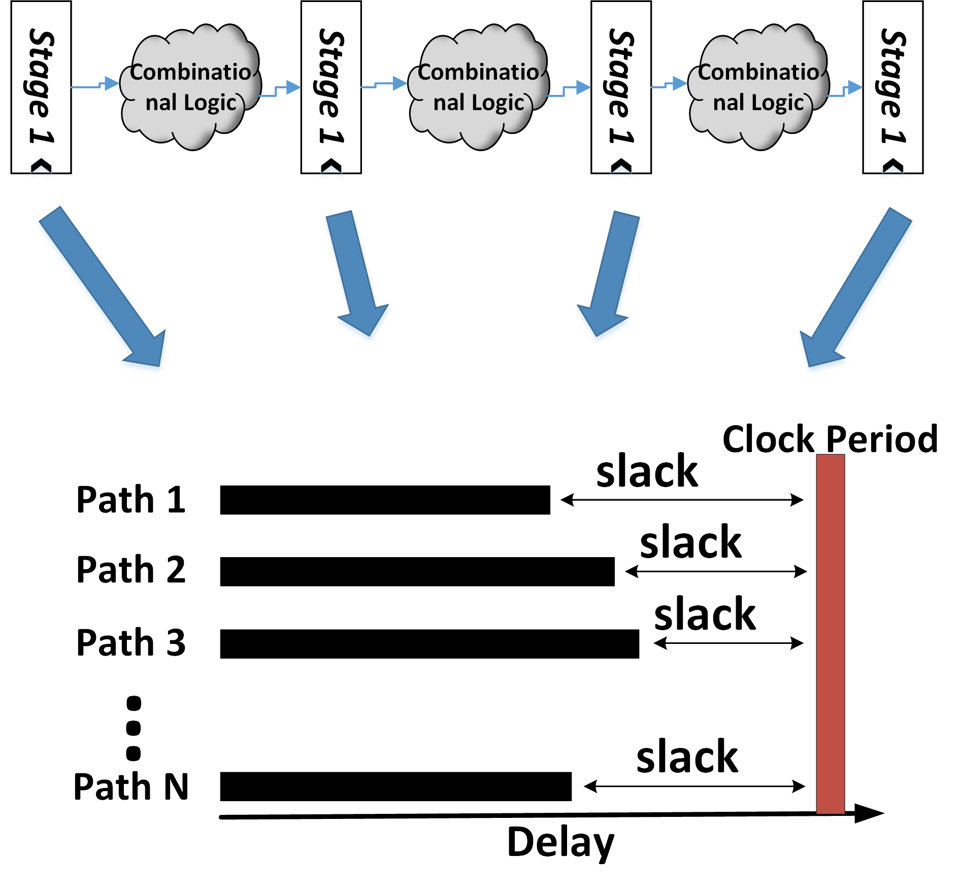
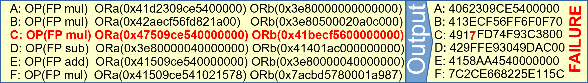

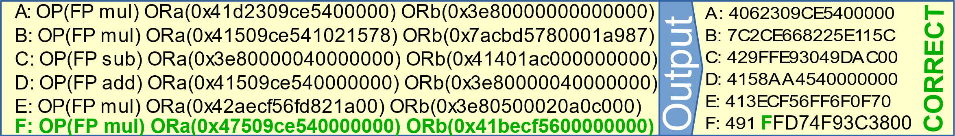
Dynamic Timing Failures in Pipelined Cores
Factors that affect timing errors:
Delay increase
Type of instruction
Input operands
Instruction execution history [1]
Deep instruction execution history impacts failure rate.
How many instructions within a sequence affect the timing error manifestation?
Window of 2 instruction impacts error rate
[1] X. Jiao et al., “Clim: A cross-level workload-aware timing error predic- tion model for functional units,” Trans. on Comp., 2018
Same Window of 2 instructions manifests NO error

Slide 7
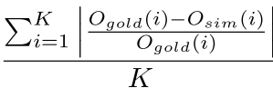
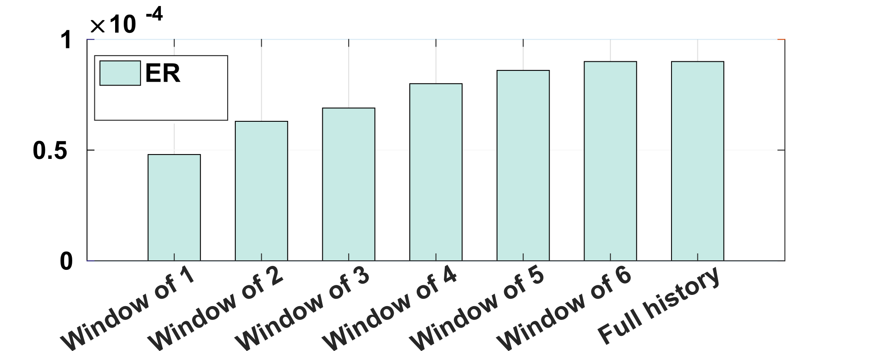
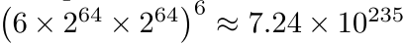

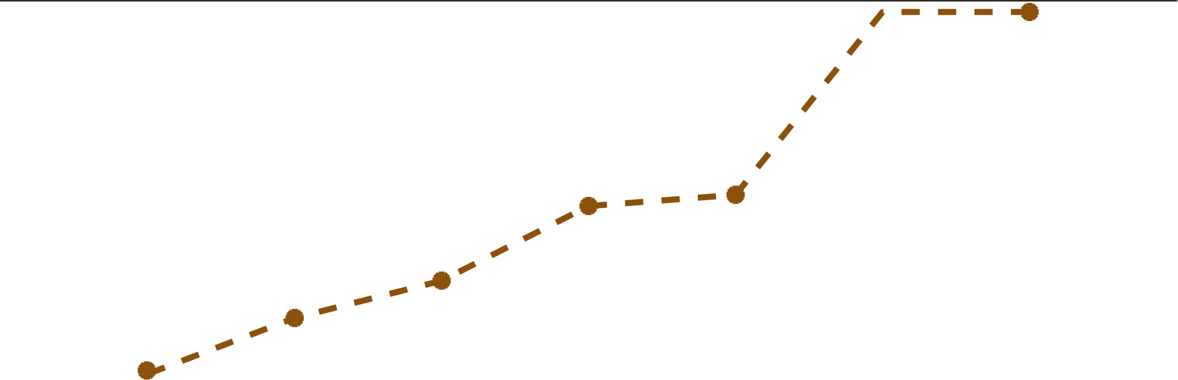

Role of Instruction Execution History
Intuition: All the concurrently executed instruction affect the error rate
Experiment Setup
- Design under test: FPU - Pipeline dept: 6
- Input: 1M instruction sequences - 15% clock reduction -> 15% variation-induced delay increase
- windows of increasing number of concurrently executed instructions
All the instructions preceding the currently executed instruction in the pipeline may trigger a timing failure in this instruction
Evaluations of all parameters that affect timing failures:
6 instruction types, two 64 bits input operands, pipeline-depth=6
ER = Faulty ISQs / # Total ISQs
avgRE =
1
27%
Error Rate (ER)
88%
Average Relative Error
avgRE
0.5
0

Slide 8
DEFCON Workflow
DEFCON: fast and accurate generation and detection of error-prone instruction sequences
Synthesis Phase: Genetic algorithm that Generates Stressful Instruction Sequences (ISQs)
Analysis Phase: Estimates application vulnerability to failures
Validation of Synthesis Phase
DEFCON records all ISQs with non-zero relative error
app sequences are splitted into 2 groups: {failure-prone, failure-free}
Yes
No
Compare

Slide 9
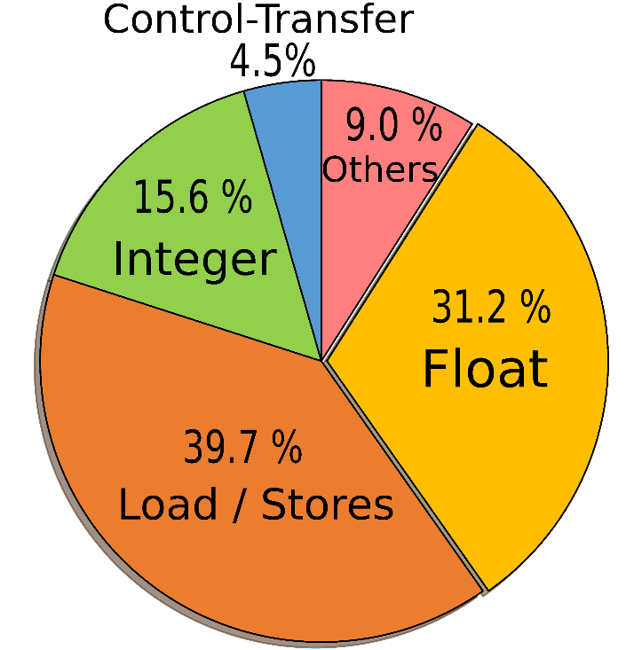
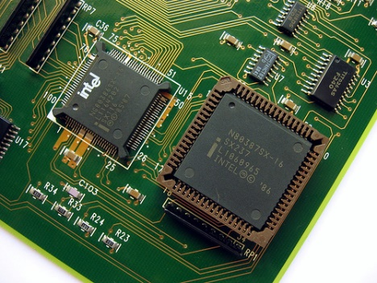
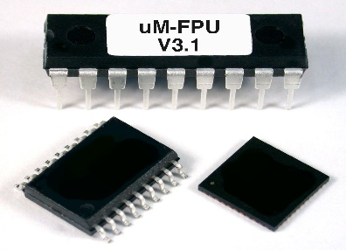
Case study: Application to an FPU
Application to the mor1kx marocchino pipeline double precision FPU based on OpenRISC Instruction Set Architecture
Targeted FPU consists of 6 pipeline stage
Excellent representatives of complex pipelined designs
Floating point operations dominant in various apps
Considered apps:
cg, is, mg and bt from NAS Suite,
hotspot and k-means from Rodinia Suite
Average instruction distribution

Slide 10
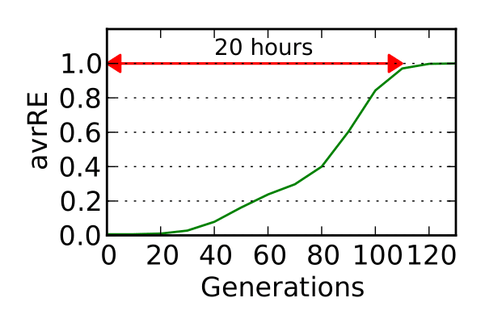
Experimental Results – GA evaluation
Values of Genetic Algorithm (GA) parameters
Run in parallel on 16 cores of an Intel Xeon system
Generations to converge: 120 generations
Time to converge: 20 hours/core
Number of chromosomes in each generation | Mutation Probability | Crossover Probability
40 | 0.6 | 0.9

Slide 11
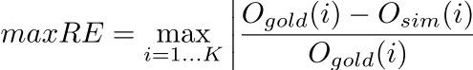
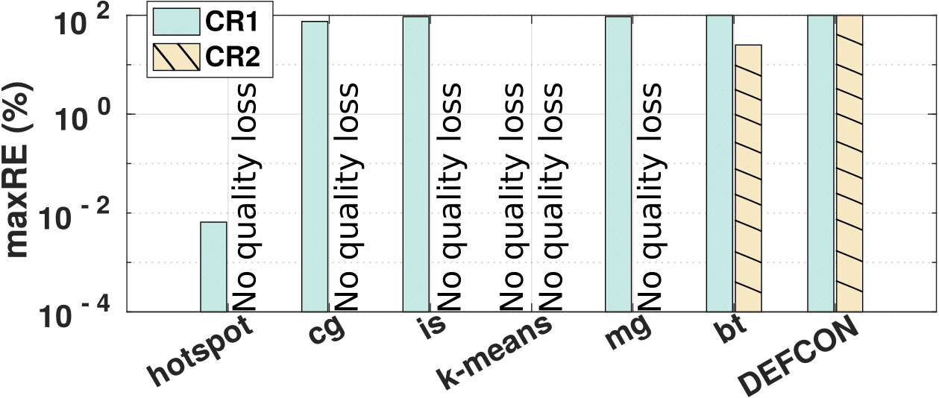
Evaluation Results Worst-case Instruction Sequences Generation
Instruction sequence that maximize output relative error
2 clock reduction (CR) levels -> degrees of variation-induced worst-case delay increase
Ogold: Error free output Osim : Simulation output
CR1 -> 15% delay increase
CR2 -> 13% delay increase
CR2
No failures: 5 / 6 apps
DEFCON reveals 98.5% on average higher maxRE
CR1
No failures: 1 / 6 app
maxRE ranges: 0.007% - 100%
DEFCON reveals significant higher or equal maxRE than apps

Slide 12
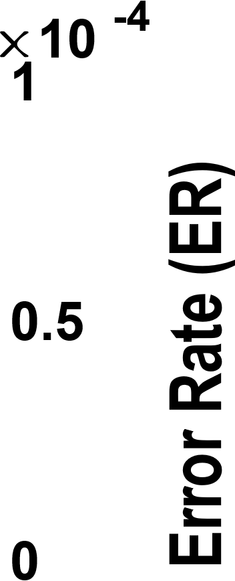
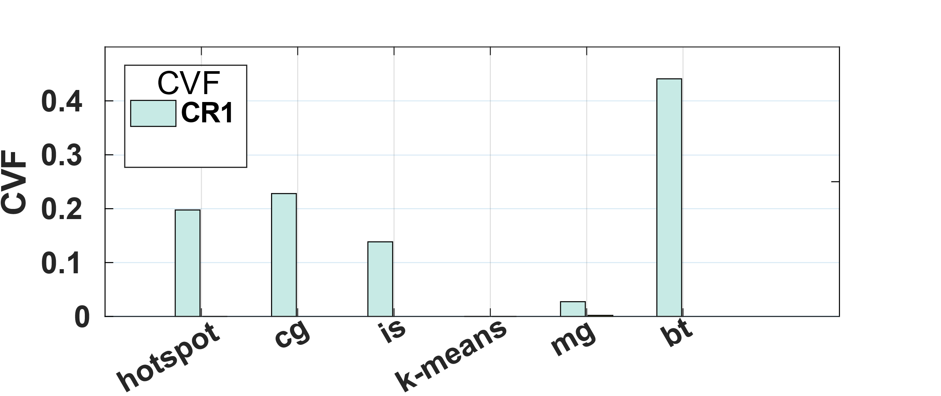
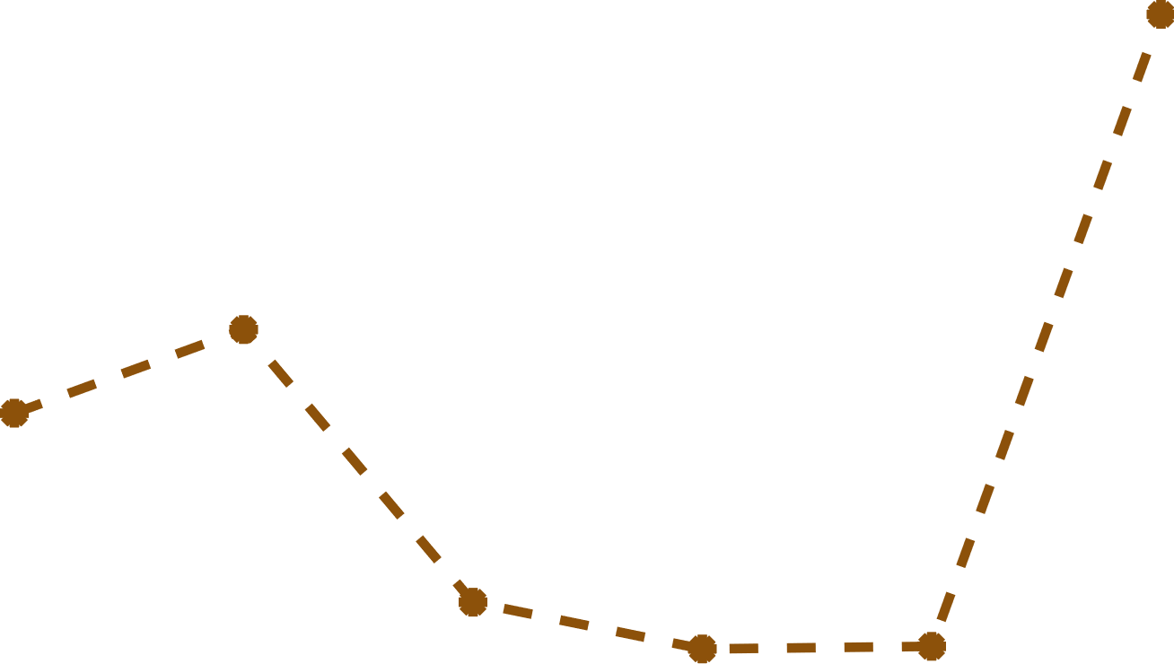
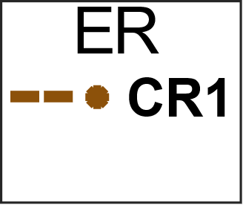






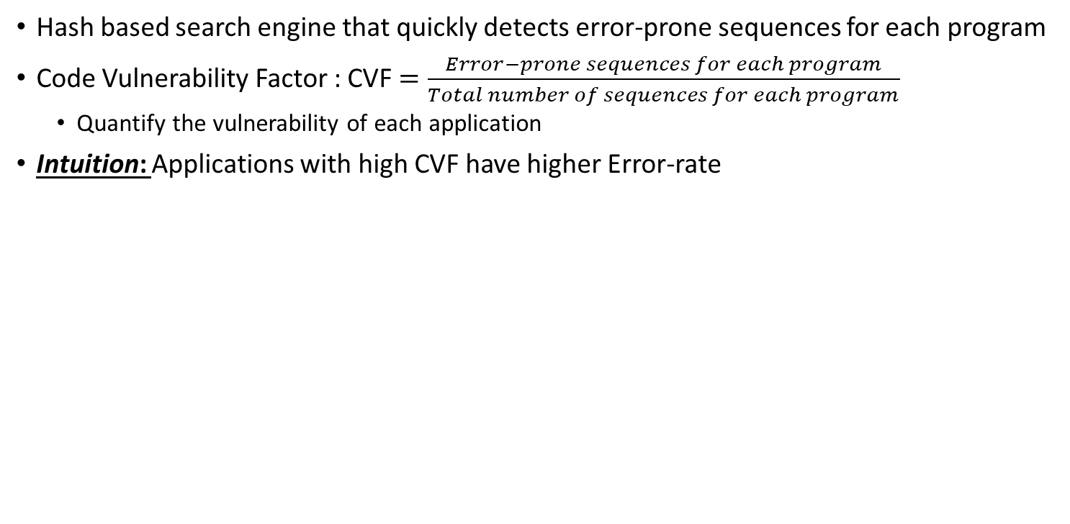
Evaluation Results – Application Vulnerability
Hash based search engine that quickly detects error-prone sequences for each program
Code Vulnerability Factor : CVF $=\frac{Error−prone sequences for each program}{Total number of sequences for each program}$
Quantify the vulnerability of each application
Intuition: Applications with high CVF have higher Error-rate
CR1 (15% clock reduction)
Highest CVF: bt, Lowest CVF: k-means
Highest ER: bt, Lowest ER: k-means
Similar correlation for the other apps
CR2 (13% clock reduction)
ER at CR1 much higher than ER at CR2
CVF at CR1 = 18x CVF at CR1
Notes:
Intuitively, we suggest that applications with a high CVF are more vulnerable to failures and thus have a higher ER

Slide 13
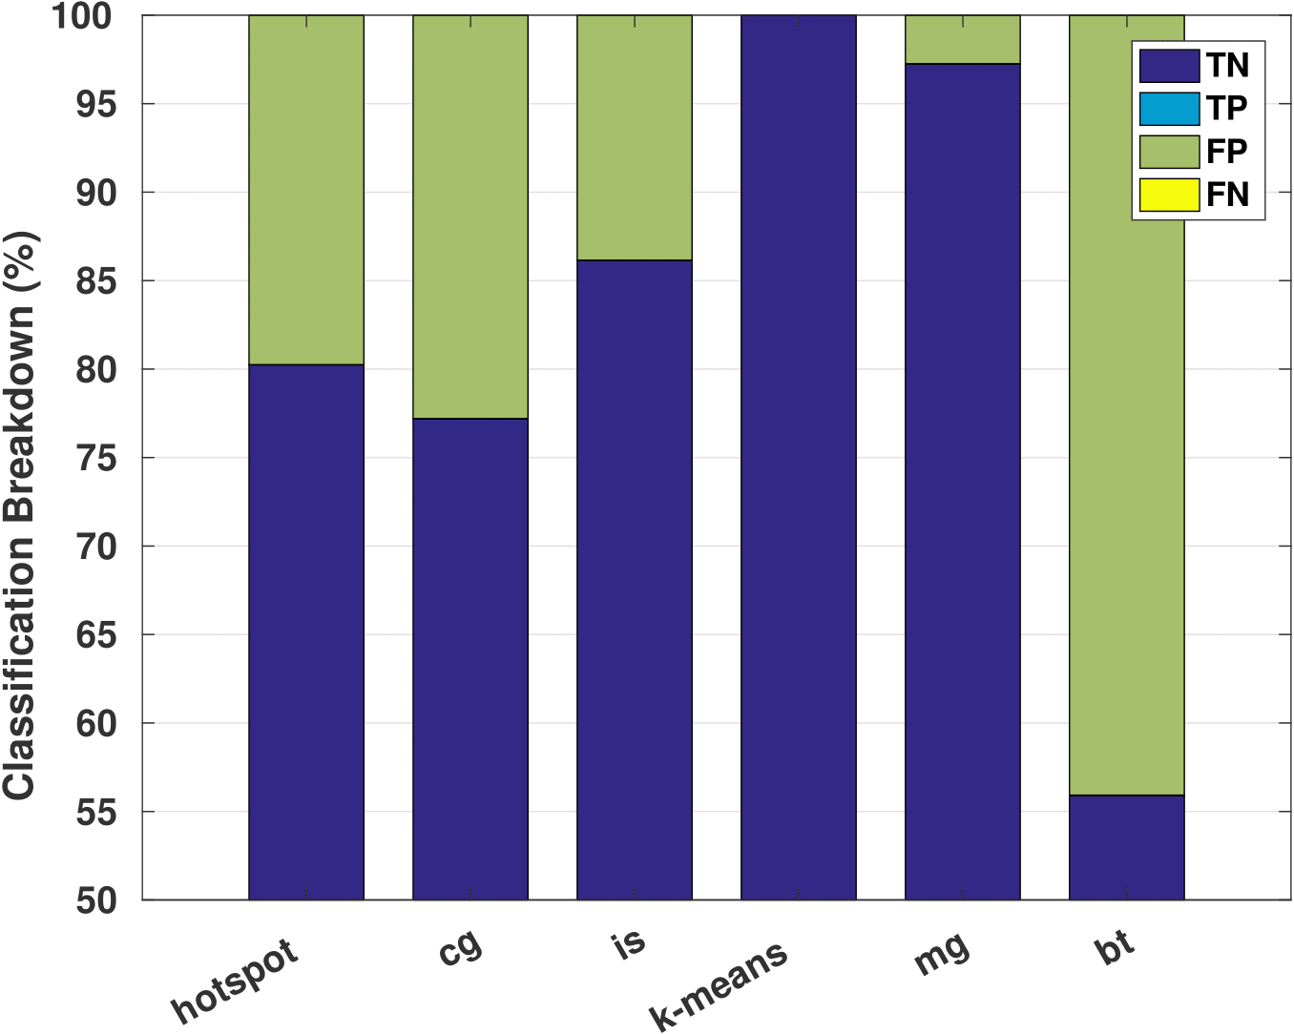
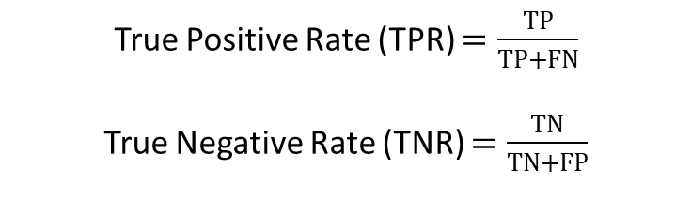
DEFCON Detection Accuracy
DEFCON outcomes of inspecting an app:
DEFCON Target: Achieve high TPR
Avoid FN outcomes
Tradeoffs between TPR and TNR
TP: correctly detection as faulty
TN: correctly detection as non-faulty
FP: incorrect detection as faulty
FN: incorrect detection as non-faulty
True Positive Rate (TPR) $=\frac{TP}{TP+FN}$
True Negative Rate (TNR) $=\frac{TN}{TN+FP}$
Average TPR | Average TNR
99.7% | 82.2%

Slide 14
Potential Usecases
Generation of stress code
DEFCON generates micro-architecture aware stress code that maximizes the quality degradation
Source of variations:
Process,
Temperature,
Voltage droops, etc..
Reduced voltage operations when CVF = 0
Power/energy efficiency

Slide 15
Potential Usecases (II)
DEFCON + Dynamic Clock adjustment = Energy savings for every app
Instruction characterization: DEFCON characterizes each instruction as:
LUT: Look-up table that contains the type of each executed instruction to checks for critical instructions in the pipeline at any instant
Main idea:
Design operates constantly at reduced voltage
(nominal Voltage = 1.1V, reduced Voltage = 0.95V)
Dynamically clock stretching in the case of an error-prone instruction sequence
Critical (error-prone)
Off-critical (error-free)
Critical: clock period increases (15% for 0.95V)
Off-critical: nominal clock period
Apps | hotspot | cg | is | K-means | mg | bt
Energy gains (%) | 26.1 | 27.2 | 28.4 | 29.3 | 28.9 | 21.2

Slide 16
Conclusion
Our contribution:
DEFCON, a fully automate framework for generating and detecting
failure-prone instruction sequences in pipelined cores
We consider for the first time the full pipeline execution history, instruction type and data dependent path excitation.
We formulate a genetic algorithm driven by accurate gate-level simulation to stochastically search for microarchitecture-aware, failure-prone code.
We detect efficiently and accurately error-prone code regions in applications binary.

Slide 17
Back-up slides

Slide 18
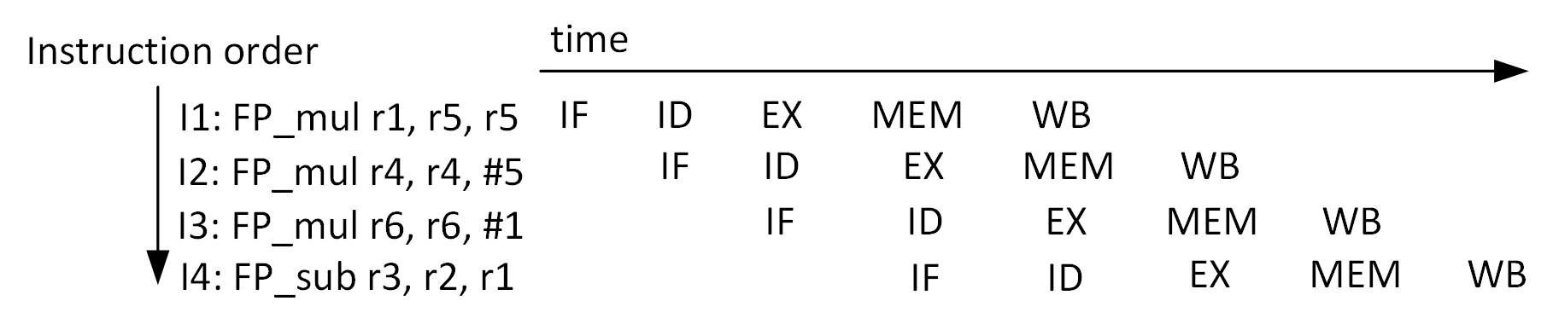
Role of Instructions Execution History
Factors that affect timing errors in pipelined designs:
Delay increase
Type of instruction
Input operands of instruction
Instruction execution history
Instruction sequences plays an important role on
timing failure occurrence
Evaluations of all parameters that affect timing failures:
6 instruction types, two 64 bits input operands, pipeline-depth=6
Besides I6, only I5 affects timing failures on I6
X. Jiao et al., “Clim: A cross-level workload-aware timing error predic- tion model for functional units,” Trans. on Comp., 2018
Experiment Setup
Design under test: FPU
Input: 1M instruction sequences
15% clock reduction -> 15% variation-induced delay increase
Pipeline dept: 6
ER = Faulty ISQs / # Total ISQs
1
27%
Error Rate (ER)
88%
Average Relative Error
avgRE
0.5
0
avgRE =
Notes:
Pipeline -> Set of instructions that executed concurrently

